Slide 1
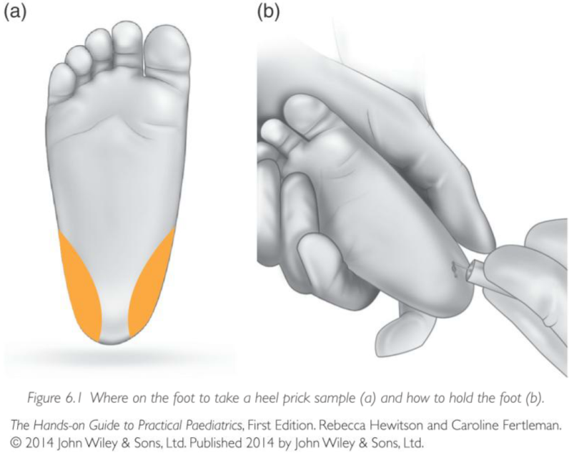
Companion Website: www.wileyhandsonguides.com/paediatrics

Slide 2
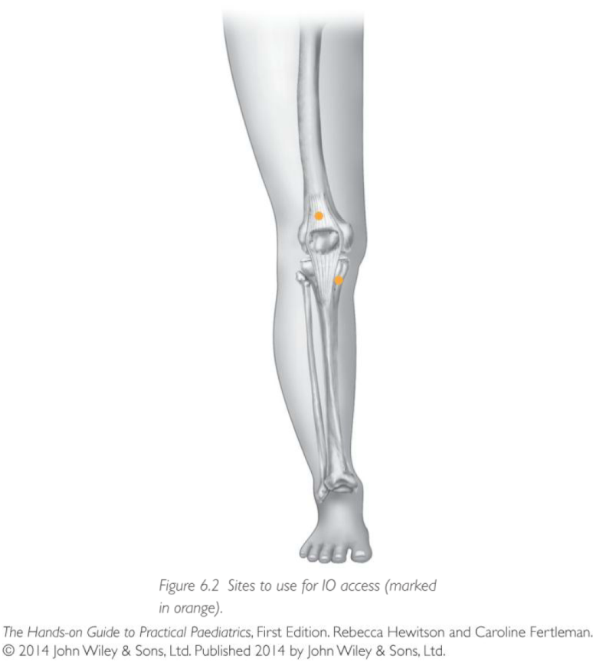
Companion Website: www.wileyhandsonguides.com/paediatrics

Slide 3
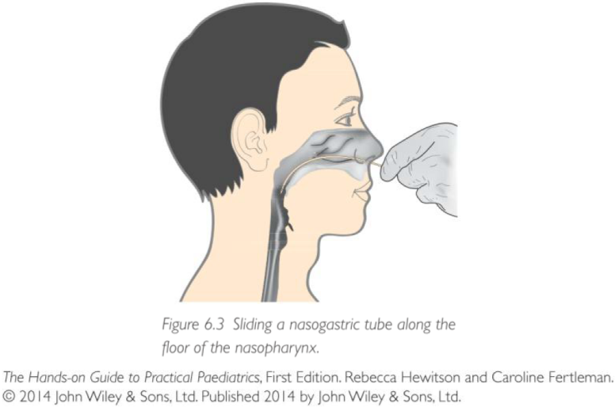
Companion Website: www.wileyhandsonguides.com/paediatrics

Slide 4
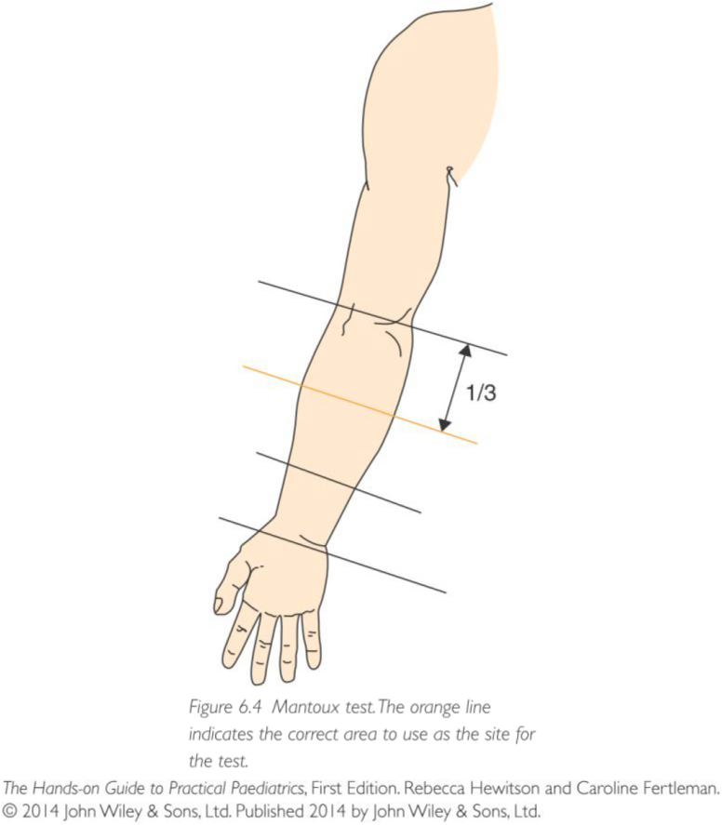
Companion Website: www.wileyhandsonguides.com/paediatrics

