Slide 1
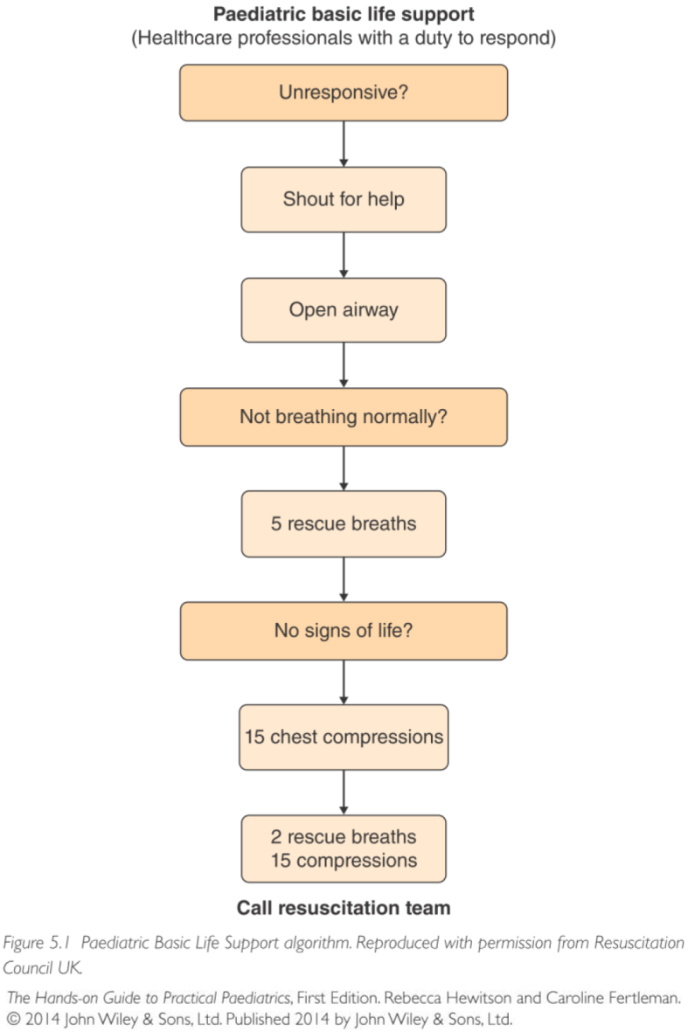
Companion Website: www.wileyhandsonguides.com/paediatrics

Slide 2
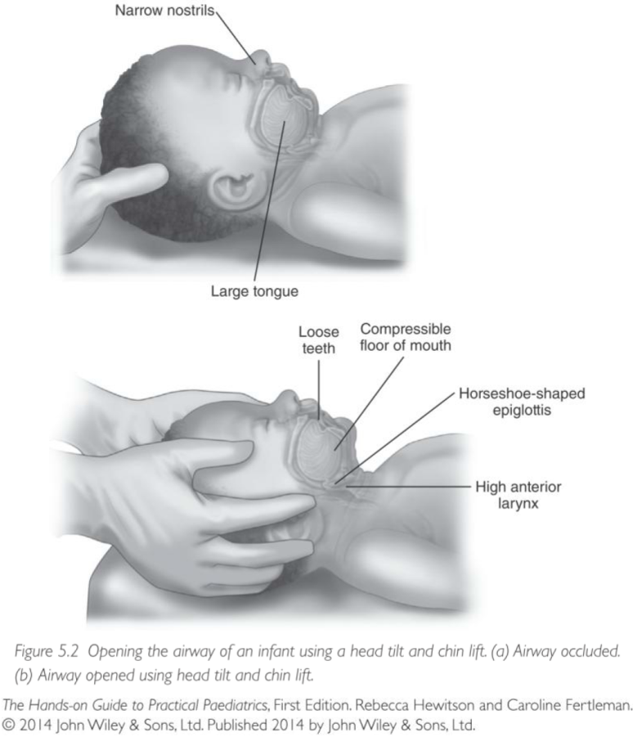
Companion Website: www.wileyhandsonguides.com/paediatrics

Slide 3

Companion Website: www.wileyhandsonguides.com/paediatrics

Slide 4
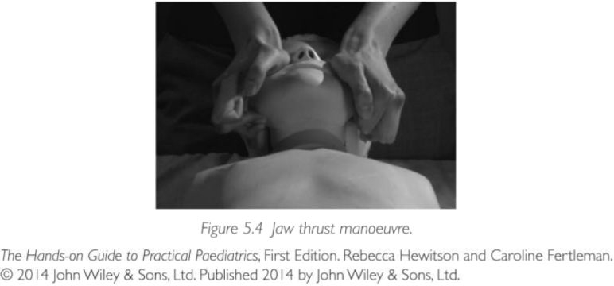
Companion Website: www.wileyhandsonguides.com/paediatrics

Slide 5
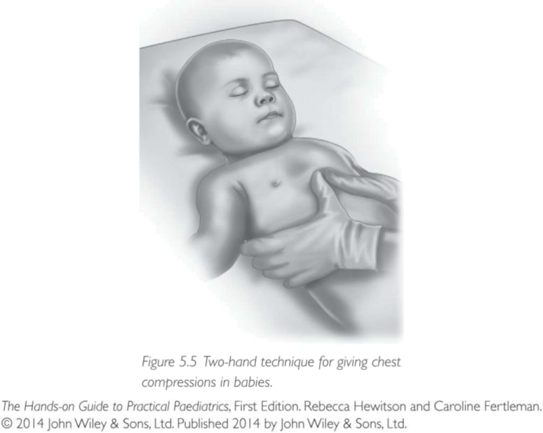
Companion Website: www.wileyhandsonguides.com/paediatrics

Slide 6
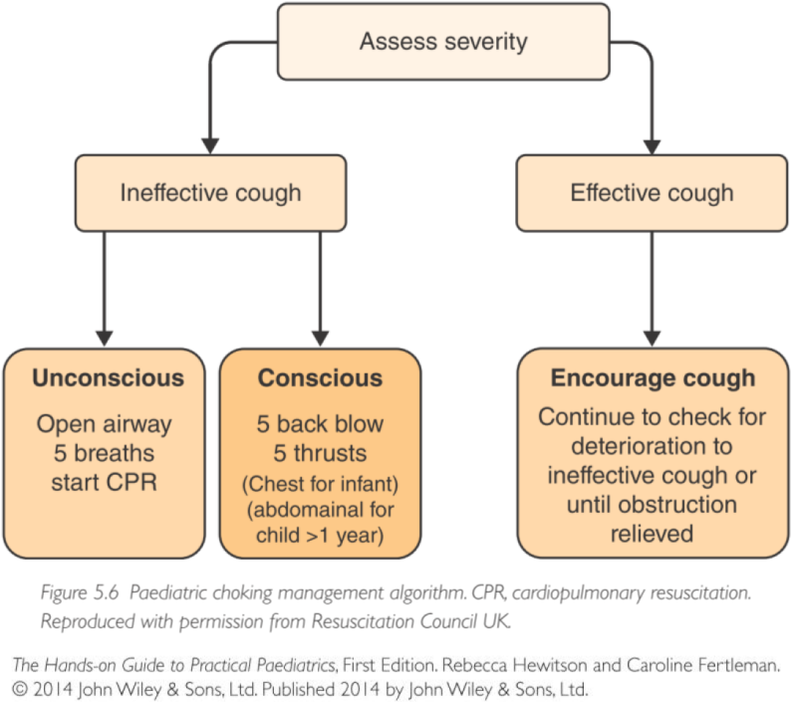
Companion Website: www.wileyhandsonguides.com/paediatrics

Slide 7
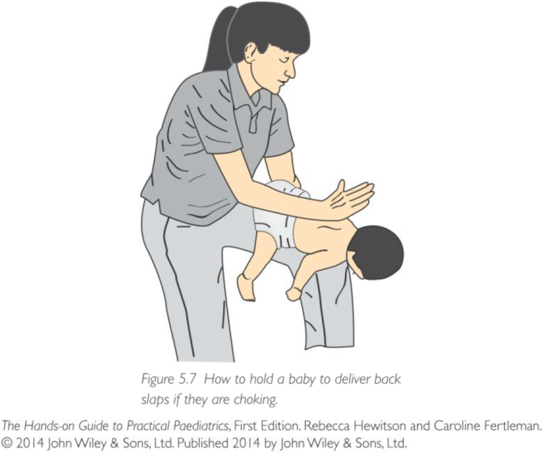
Companion Website: www.wileyhandsonguides.com/paediatrics

Slide 8

Companion Website: www.wileyhandsonguides.com/paediatrics

Slide 9
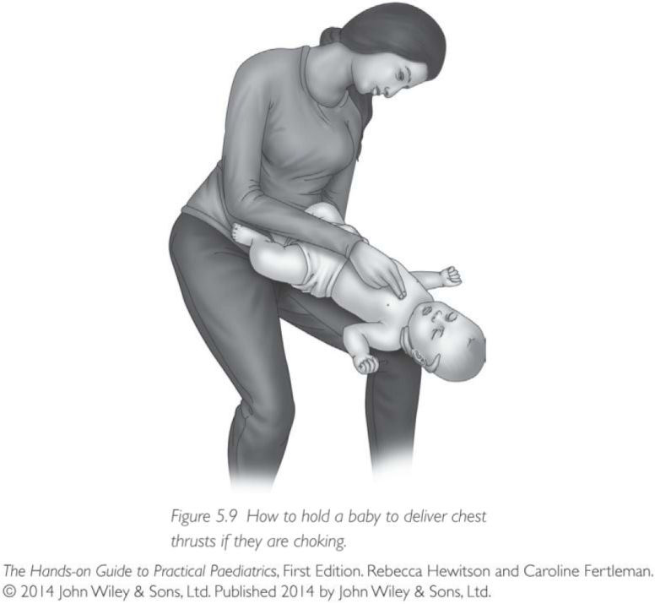
Companion Website: www.wileyhandsonguides.com/paediatrics

Slide 10
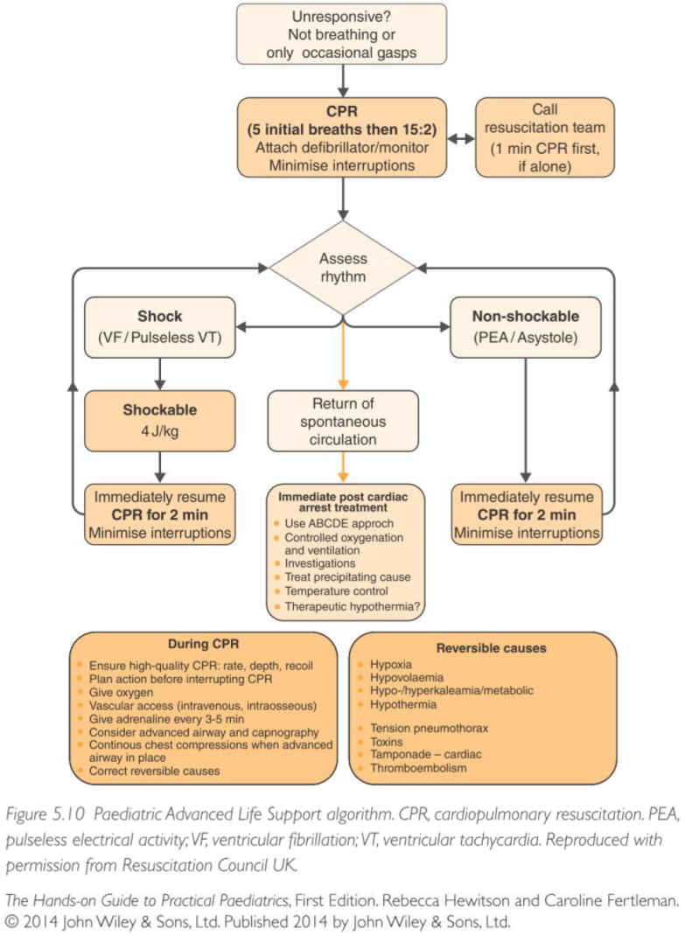
Companion Website: www.wileyhandsonguides.com/paediatrics

Slide 11

Companion Website: www.wileyhandsonguides.com/paediatrics

Slide 12
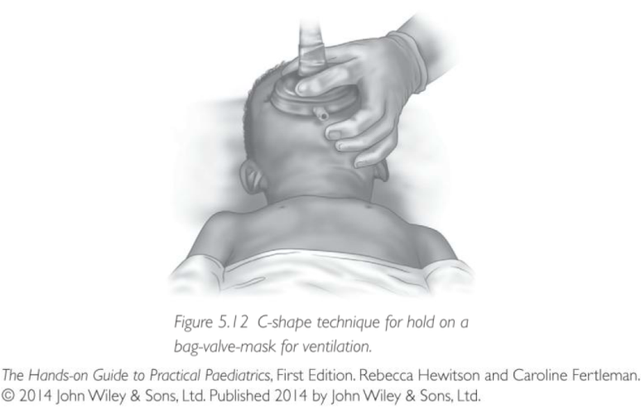
Companion Website: www.wileyhandsonguides.com/paediatrics

Slide 13
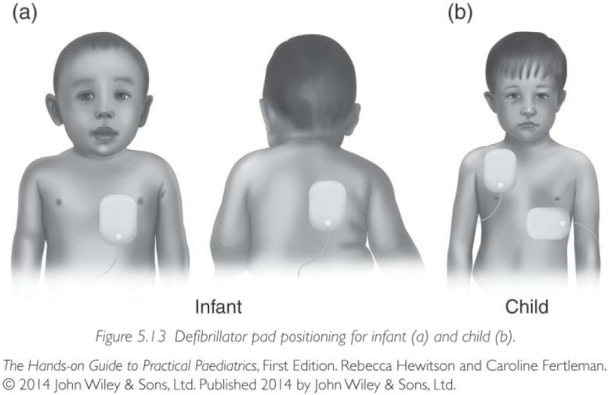
Companion Website: www.wileyhandsonguides.com/paediatrics

Slide 14
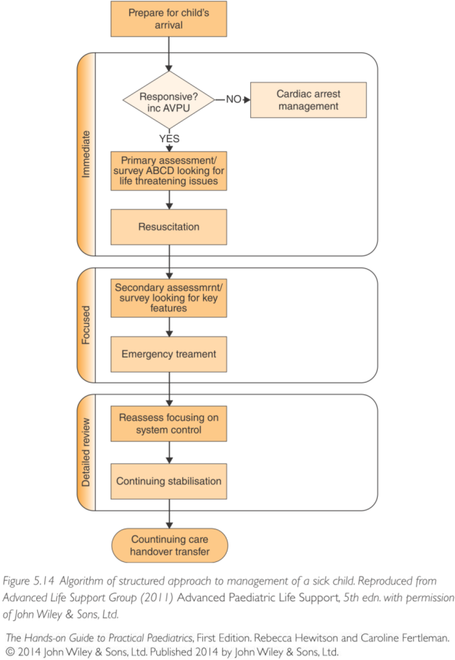
Companion Website: www.wileyhandsonguides.com/paediatrics

Slide 15
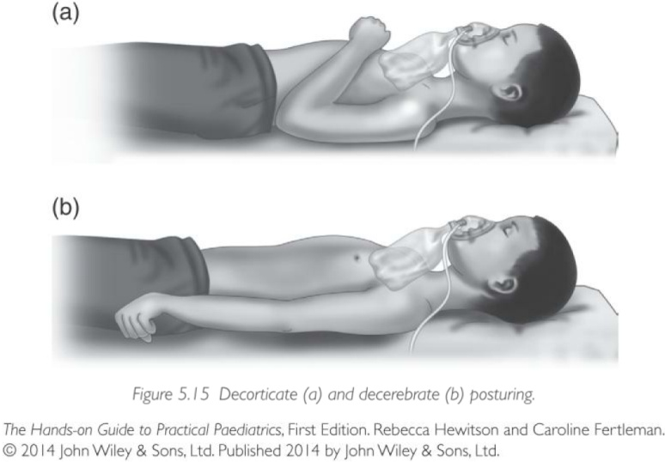
Companion Website: www.wileyhandsonguides.com/paediatrics

Slide 16
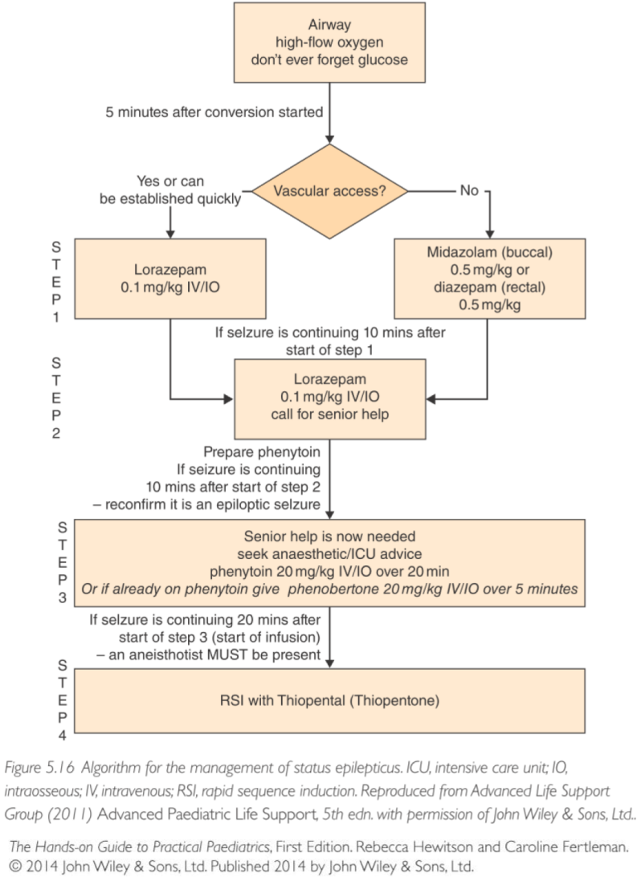
Companion Website: www.wileyhandsonguides.com/paediatrics

Slide 17
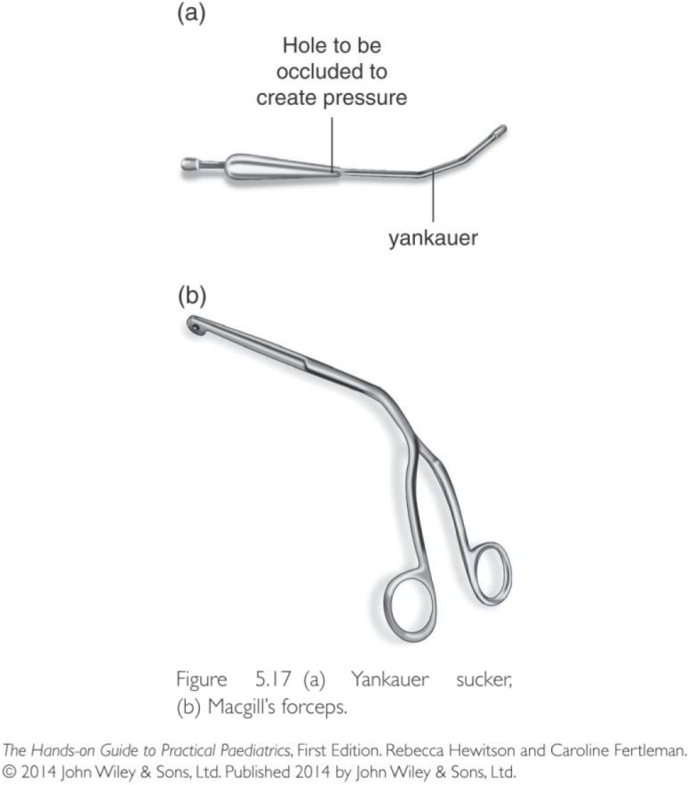
Companion Website: www.wileyhandsonguides.com/paediatrics

